Slide 1



Department of Computer Science and Engineering
DYNAMIC BLOCKCHAIN ADOPTION FOR GLOBAL AGRICULTURAL PRODUCTS USING CLOUD SERVICES.
Ashritha P (211419104025)
Desappriya G D (211419104053)
Dhivya P (211419104065)
Guide & co-ordinator
Dr.Kavitha Subramani M.E,Ph.D.,

Slide 2
Abstract
In the supply chains of emerging economies, the livelihoods of smallholder farmers are subpar because of financial exclusion, fraud, exploitation, corruption, deception, child labour, and other acts typically committed by powerful actors. A problem with social sustainability arises from this situation, and immediate action is required. In our viewpoint article, we adopt a customary strategy to flash academic interest in examining and creating research needs on the most proficient method to utilize innovation to address this current and basic maintainability and production network concern. Blockchain can be used to address complexities, inefficiencies, and other societal issues. The hash technique, which is crucial for online payments and transactions, is used to execute the blockchain concept, The hashing algorithm used to secure the transaction in our perspective article is Secured hash algorithm which is simply represented as SHA-256. Regardless of the size of the input transaction, this hashing algorithm always produces an output of 256 bits or 32 bytes. That is, if we use SHA-256 to hash two different inputs, say a 1 gigabyte movie and a 5-kilobyte image, The generated hash will be 256 bits long in dual instance. Additionally, it enables users to instantly purchase the desired products by making an online payment, and Amazon Web Service is used to permanently store information about product availability, price, and payment history in the cloud. Users can see a wide range of products and immediately purchase the ones they want.

Slide 3
Literature Survey
Year | Author | Title | Methodology | Merits and Demerits | Future scope
2022 | Angel Infanta Ramesh, Ayush Raghuwanshi, Eshan Goel, Dakshayani G | An E-store for Farmers Buying Seeds | A fully-fledged Electronic Commerce website for the farmers based on a Direct-to- Consumer marketing strategy. It eliminates the | Merits : Reduces the time and efforts spent but also entrusts the | Future work can be done by taking security concerns into account and leveraging the

Slide 4
Literature Survey
Year | Author | Title | Methodology | Merits and Demerits | Future scope
2021 | Suraya Abu Bakar, Liew Pei Ling | Fruit Ordering System through Fruity Healthy Mobile Application | The objective of this project is to help farmers increase their sales market by developing a fruit ordering application that allows customers to purchase fruits. | Merits : It is compatible with Android, iOS, Harmony OS, and Windows phones | Customers’ database can be recorded so that sellers can choose who to target and how to enhance sales in the future.

Slide 5
Literature Survey
Year | Author | Title | Methodology | Merits and Demerits | Future scope
2022 | Yuting Li, Chunqiao Tan | Dynamic block chain adoption for freshness keeping in the fresh agricultural | agricultural products on E- commerce increased the difficulty of maintaining the greenness and freshness in delivery. | Merits: freshness of the fruits is maintained even at the time of delivery. But the freshers is | To maintain the freshness new block technology is Used so that freshness is maintained.

Slide 6
Literature Survey
Year | Author | Title | Methodology | Merits and Demerits | Future scope
2022 | Anil kumar Anal, Tauji w.Tsusaka , Khwanchol Kamapan | Adoption of block chain Technology for Enhanced traceability of livestock- based products. | This paper reviews studies on blockchain technology applications to the agri-food supply chain system and food industry and discusses potential adaptation of blockchain technology for livestock-based products. | This helps in tracking of the product and its information regarding who the stakeholders and what they are selling. | Along with tracking it can also enable the receiver to know it's supplier.

Slide 7
Proposed System
The sharing economy has recently grown dramatically and has led to changes in manufacturing and supply chain operations. Technological advances and the increasing popularity of mobile devices and apps have led to the establishment of numerous platforms, such as Airbnb, Uber, and eBay. These platforms offer various sharing economy services, which can be free or paid, or operate through bartering and exchanging goods and services. The sharing economy has permeated many aspects of our daily lives, and includes the sharing of homes, rides, clothes, books, toys, and digital products. According to statista.com, about 44.8 million adults used sharing economy services in the US in 2016, and this figure was forecasted to increase to 86.5 million by 2021.1 Consumer-to-consumer product trading (C2C-PT), a form of sharing economy, is becoming increasingly popular. Increased Internet and smartphone usage has enabled people to engage in C2C-PT activities with friends, relatives, neighbors, and others worldwide.

Slide 8
Software / Hardware used
Software Requirements:
FRONT END : J2EE (JSP)
BACK END : JAVA (SERVLET), AWS
OPERATING SYSTEM : WINDOWS 7
IDE : ECLIPSE
Hardware requirements:
PROCESSOR : DUAL CORE 2 DUOS
RAM : 2 GB DD RAM
HARD DISK : 250 GB

Slide 9
Methodology used
LIST OF MODULES
CUSTOMER
FARMER
ADMINISTRATOR
ALGORITHM USED
SECURED HASH ALGORITHM(SHA-256)

Slide 10
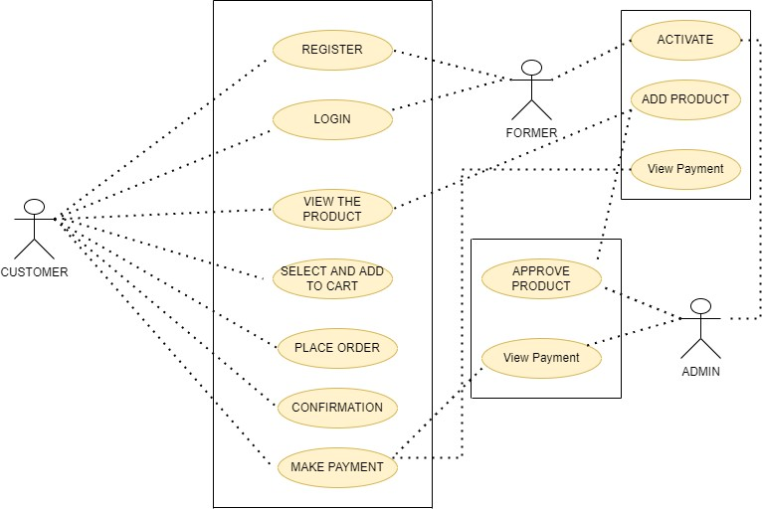
System Design – Use Case Diagram

Slide 11
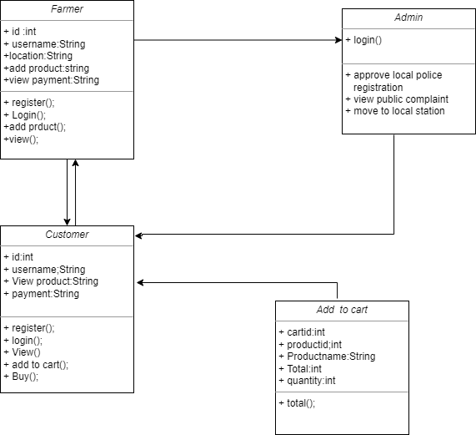
System Design – Class Diagram

Slide 12
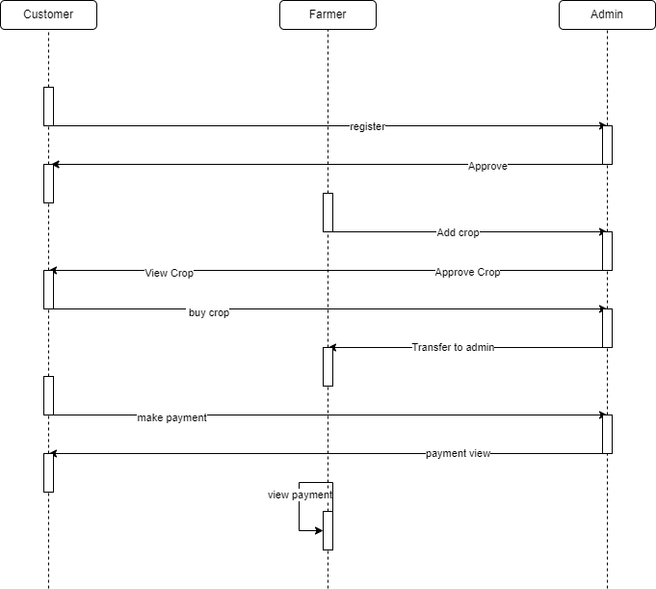
System Design – Sequence diagram

Slide 13
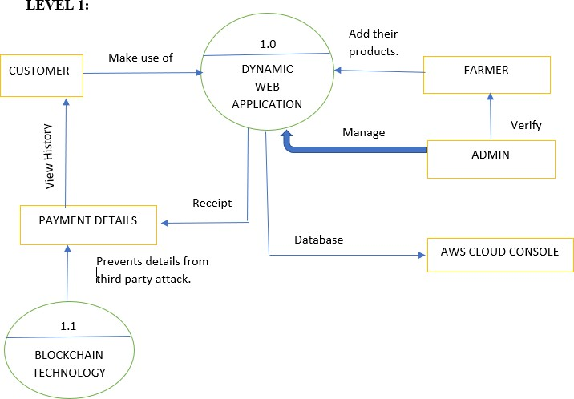
System Design – Data flow diagram

Slide 14
Module Description
USER
In user module, user can view all the products added by the farmer’s and can proceed to buy the products if he/she is in need of it, the products that they choose to buy can be delivered either to their place and it can be purchased directly from the farmer by the customer.
FARMER
In farmer module, farmers can add the product and check the product details. The farmer fixes the delivery mode as deliverable or not deliverable. Every payment will be view by the farmer like payment history and complete account details.
ADMIN
In admin module, admin should activate every user registration. if user register their details, it will be notified to the admin and admin can either accept the registration or deny it. Admins have the access to approve the farmer added product. Maintain all the user list, product list and all the details about the application.

Slide 15
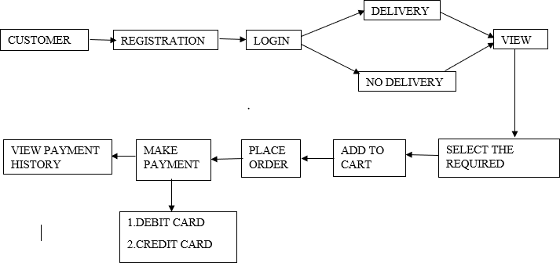
Module Description
USER
.

Slide 16
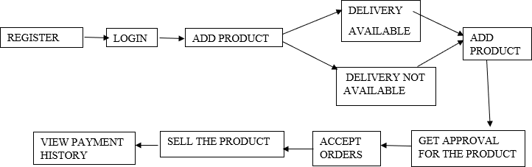
Module Description
FARMER

Slide 17
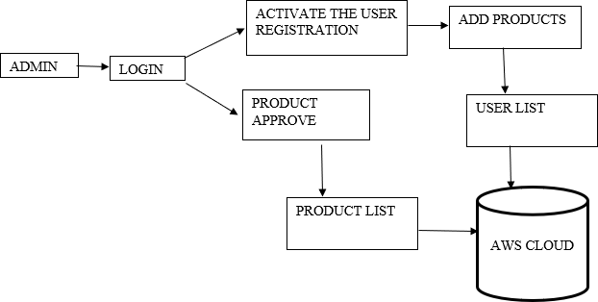
Module Description
ADMIN

Slide 18
TEST CASES AND REPORT
TEST REPORT:01
PRODUCT: Seller Registering to the application
USECASE: Seller Registration
Test case id | Testcase/ action to be performed | Expected Result | Actual Result | Pass/Fail
1 | The seller/Farmer registers himself | Registered Successfully | Registered Successfully | Pass
2 | Adding Products as shown in A.2.3.2 | Adds the products successfully | Adds the product Successfully | Pass

Slide 19
TEST CASES AND REPORT
TEST REPORT:02
PRODUCT: Aws cloud console for cloud storage
USECASE: Aws cloud storage
Testcase id | Testcase/Action to be performed | Expected Result | Actual Result | Pass/Fail
1 | The database is connected to the cloud and can view the database as shown in A.2.2 | Successfully done | Successfully done | Pass

Slide 20
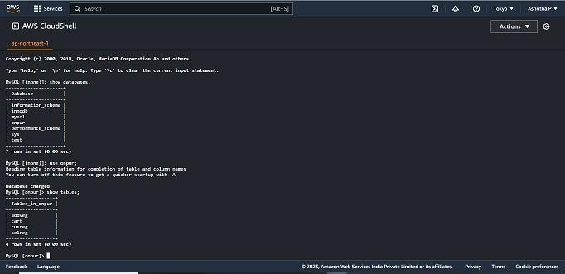
Screen Shots

Slide 21
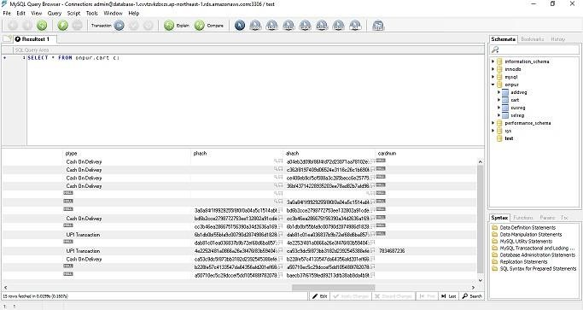
Screen Shots

Slide 22
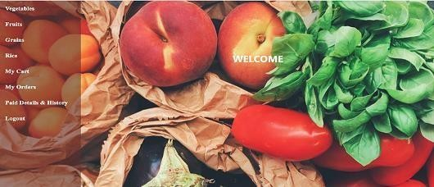
Screen Shots

Slide 23
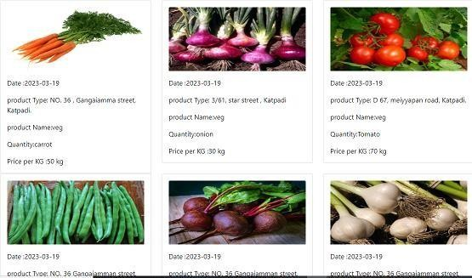
Screen Shots

Slide 24
Conclusion / Future Enhancement
In this the transaction between the consumers are made easier. This helps us to understand the issues of customers easily. The art of doing business is made comfortable for every farmer. farmers are benefited by selling online and it is made easier for them to understand. It acts like a channel for businesses to reach out to customers and a way for a community to work together to solve problems for customers. The methods that are used to improve this application in the future are Setting up a genuine database system, Increasing the number of messages exchanged and the size of those messages while also increasing the efficiency of protocols and Application of two or more algorithms.

Slide 25
Reference Paper/ URL
A. Aflaki, B. Feldman, and R. Swinney, “Becoming strategic: Endogenous consumer time preferences and multiperiod pricing,” Oper. Res., vol. 68, no. 4, pp. 1116–1131, 2020.
[2] S. Asian and X. Nie, “Coordination in supply chains with uncertain demand and disruption risks: Existence, analysis, and insight,” IEEE Trans. Syst., Man, Cybern. Syst., vol. 44, no. 9, pp. 1139–1154, Sep. 2014.
[3] Y. Aviv and A. Pazgal, “Optimal pricing of seasonal products in the presence of forward-looking consumers,” Manuf. Service Oper. Manage., vol. 10, no. 3, pp. 339–359, 2008.
[4] I. Bellos, M. Ferguson, and L. B. Toktay, “The car sharing economy: Interaction of business model choice and product line design,” Manuf. Service Oper. Manage., vol. 19, no. 2, pp. 185–201, 2017.
[5] S. Benjaafar and M. Hu, “Operations management in the age of the sharing economy: What is old and what is new?,” Manuf. Service Oper. Manage., vol. 22, no. 1, pp. 93–101, 2019.
[6]S. Benjaafar, G. Kong, X. Li, and C. Courcoubetis, “Peer-to-peer product sharing: Implications for ownership, usage, and social welfare in the sharing economy,” Manage. Sci., vol. 65, no. 2, pp. 477–493, 2018.
[7] N. Boysen, D. Briskorn, and S. Schwerdfeger, “Matching supply and demand in a sharing economy: Classification, computational complexity, and application,” Eur. J. Oper. Res., vol. 278, no. 2, pp. 578–595, 2019.

